Slide 1
Loops

Slide 2
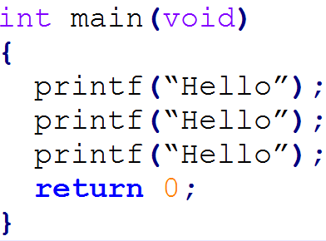
Do it again, and again, and again...
Sometimes we want to repeat something

Slide 3
Can We Do Better?
Easy for a few repetitions
What about 10? 20? 100? 1,000,000?
Enter loops
Repeat code, but only write it once

Slide 4

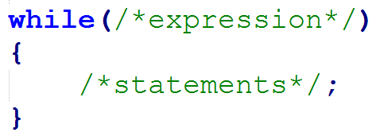
while Loop
Format:
or
Read as: while expression is true, execute the statements
Stops when expression is false

Slide 5
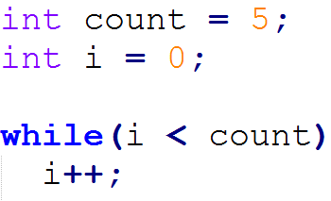
Simple while loop
What does this loop do?

Slide 6
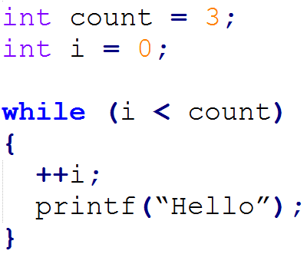
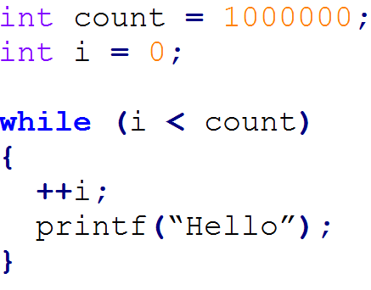
More Examples (1,000,000? No Problem)

Slide 7
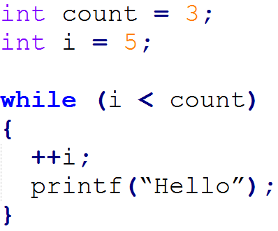
A Loop That Doesn't Loop
expression is false at start
The loop never starts

Slide 8
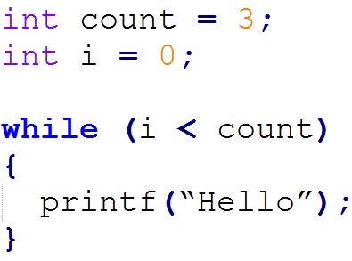
A Loop That Never Ends
expression is always true
Infinite loop

Slide 9
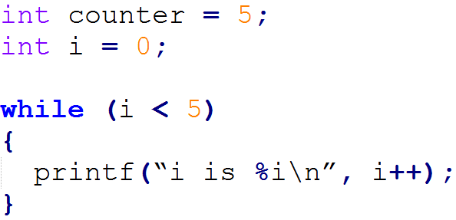
Self Check
What's the output of this code?

Slide 10
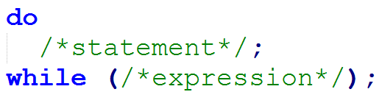
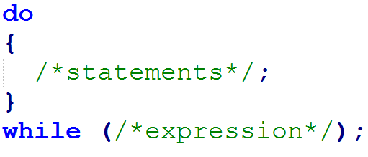
do while Loop (Do it at least once)
Format:
or
Checks expression at the end
Always executes statements once

Slide 11
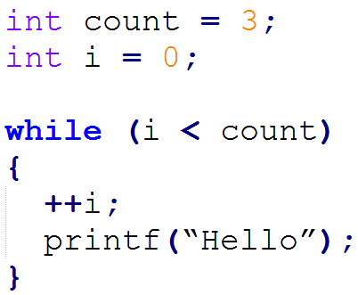
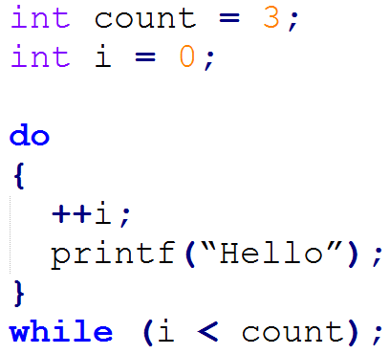
Simple Example (Both have the same output)

Slide 12
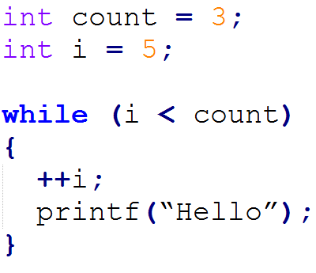
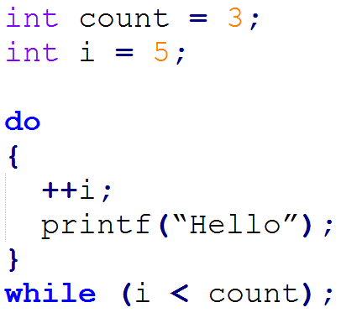
Do these have the same output?

Slide 13
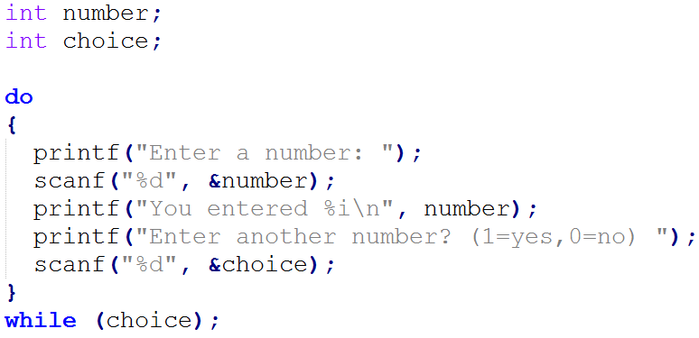
Practical Example

Slide 14
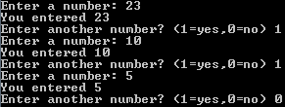
Practical Example Output

Slide 15
for Loop (A more compact loop)
All the while loops had the same three things:
A variable for counting: i = 0;
A check to continue the loop: i < count;
Update the counting variable: ++i;
for loop combines these into a single line

Slide 16
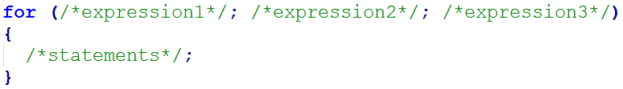
for Loop
Format:
or

Slide 17
How do you read that?
Evaluate expression1, do this once at the beginning of the loop
If expression2 is true, execute statement. If false, end the loop
Evaluate expression3
Goto step 2

Slide 18
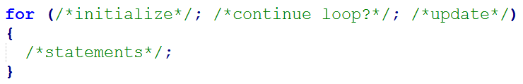
Another Way To Think About It
Initialize counter variable
Check to see if loop should continue
Update counter variable
Goto step 2

Slide 19
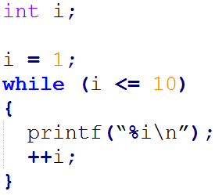
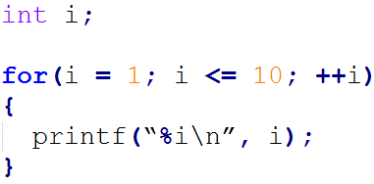
Simple Example

Slide 20
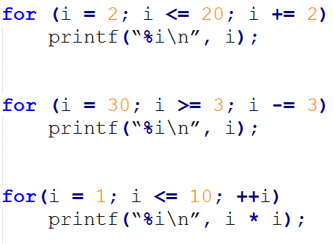
More Examples
Count to 20 by 2s
Count down from 30 by 3s
Squares of 1 to 10

Slide 21
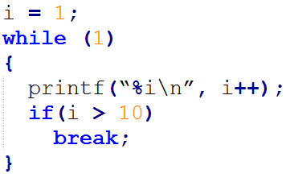
break (Stop that loop now)
Used to stop a loop prematurely
Using break to end an infinite loop:
What does this print out?

Slide 22
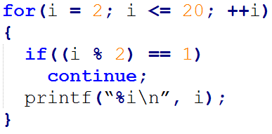
continue (Skip to the next time through)
Stops executing code and goes back to the beginning of the loop
What does this code output?

